Slide 1
Adaptive Motor Monitoring System Based on Machine Learning Batch Training
Design Review #2
Team 17
Group Member:
Zhang Ting;Cheng Yiwei;
Zhou Chenxin;Zhu Junru;
Company Sponsor: CyberInsight
Company Mentor: Fang Chen
Wentao Li
Project Instructor: Prof. Ma Chengbin
Presented By Team 17
Oct 31. 2018

Slide 2

Review of problem
Modification of project
Conceptual designs
Design Evaluation
Current Progress
Contents

Slide 3


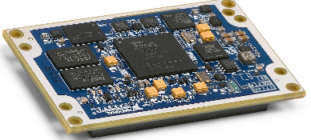

Review of problem
Possible solution
Normal
Data Behavior
Most Recent
Data
Behavior
- Traditional cloud one-time training of monitoring motor health
- Adaptive training on the edge side to monitor motor health
Viewable Web-UI interface
Compare the recent data with the one-time model
Cloud
Edge adaptive Training:
Edge training -> guarantee efficiency
Adaptive training -> suitable in different circumstances
Other requirements:
High accuracy
Remote control surface
Low local memory requirement
Adaptive model on
Edge side
Cloud One-time Training:
Cloud training -> low-efficiency; Easy to lose datum
One-time training -> Non-adaptive;
An industrial motor
One-time model
Figure 1: cloud one-time training approach
* Figure 1 from https://www.vecteezy.com/

Slide 4
Modification of project
-Customer Need & Engineering Specifications
Customer Requirement:
Edge computing
Adaptabilty to different motors
High testing accuracy
Remote control
Customer Requirement:
Edge computing
Adaptabilty to different motors
High testing accuracy
Remote control
Customer Requirement:
Edge computing
Adaptabilty to different motors
High testing accuracy
Remote control
Customer Requirement:
Edge computing
Adaptabilty to different motors
High testing accuracy
Remote control : Start, Restart, Stop the process of training model
Engineering Specification:
High Training Accuracy > 95%
Training Speed: 100 bits/s
Total memory required <20 M
Response Time < 200ms with 0 loss
Engineering Specification:
High Training Accuracy > 95%
Training Speed: 50 data/s
Response Time < 200ms with 0 loss
Engineering Specification:
Accuracy in training stage> 93%
Accuracy after the training stage> 95%
Training Speed: 100 bits/s
Total memory required <20 M
Response Time < 200ms with 0 loss

Slide 5
Conceptual Designs
- Morphological analysis
Proper quantity
Indicating the health of motor
Train data
Proper quantity
Indicating the health of motor
An industrial motor
An adaptive model
An adaptive model
An adaptive edge training algorithm monitoring the motor
Web UI services
Real-time motor data
Raspberry Pi
Final User interface
Figure 2: Morphological analysis of the project

Slide 6
Conceptual Designs
- Adaptive motor monitoring system on edge side
Train an adaptive model
Proper quantity indicating the health of motor
SPCA
(Simple principal component analysis)
T 2 statistic
Q statistic
SOM
(Self organizing map)
MQE statistic
GMM
(Gaussian mixture method)
CV statistic
Figure 3 Sub-tasks

Slide 7
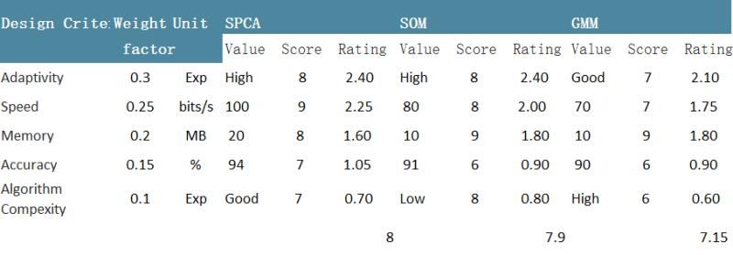
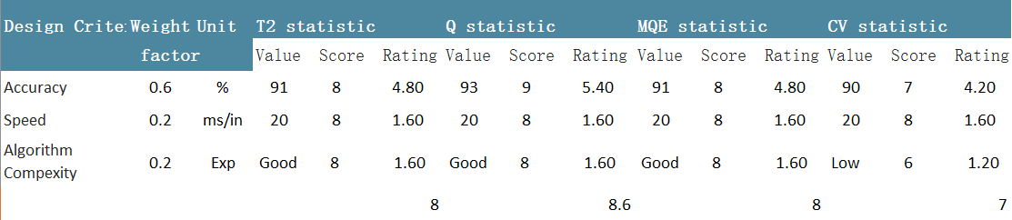
Design Evaluation
Design Criterion for adaptive model:
Adaptivity
Speed
Memory
Accuracy
Algorithm complexity
Design Criterion for proper quantity:
Accuracy
Speed
Algorithm complexity
Table 1： Decision Matrix

Slide 8
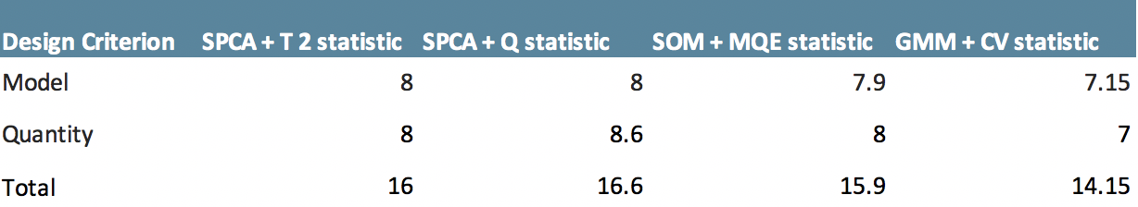
Design Evaluation
Table 1： Decision Matrix(Continued)
Final design concept = SPCA + Q statistics

Slide 9
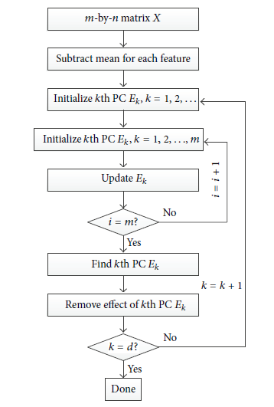
Current Progress
- Implementation of SPCA+Q statistics
Input Data Row

Slide 10
Project Schedule
Sep 25
Oct
04
Oct 11
Oct
20
Oct
29
Nov
8
Nov
17
Nov
26
Dec 05
A
100%
B
100%
C
100%
D
15%
E
F
Completed
Incomplete
Checkpoint Time
A
Literature Research
D
Embed the algorithm into the system
B
Implementation of the algorithms
F
Design of Web UI for a final demo
C
Comparison and test
Final test
E

Slide 11
Thank you!

Slide 12
Q & A

